Slide 1
Minimalist Art of Investing
Ep 3: All about Retirement Planning
Sandeep Tyagi

Slide 2
Recap: First Two Episodes
Difficult to predict one year returns, easier to predict over long periods
On an average Sensex gave 11.4% returns (CAGR) over 10-years rolling returns
FD returns average is at 8.2%
60-40 model portfolio has 10.76% average returns
Savings rate of 25 to 40% is healthy
Buying vs Renting – Investment returns, Asset appreciation, Rent, Interest Rate, Tenure of mortgage and investment are major factors
Estimating savings, Buying vs Renting templates are provided on Gulaq website

Slide 3
Why do you need to plan for Retirement?
Retirement planning is the biggest savings goal. The Goal is to meet the living expenses after retirement.
Financial independence: Having a steady flow of income post-retirement helps in financial stability post retirement.
Changing Family Dynamics: As families evolve from joint finances to independent finances, one must plan for their situation
Insufficient social security systems: Lack of retirement benefits for senior citizens. One medical bill can jeopardize the savings
Lack of pensions in private sector – Majority of the workforce is employed in private sector. A lack of pension means, employees have to carefully plan their retirement

Slide 4
Retirement Age
At what age are you planning to retire?
<40
40 to 50
50 to 60
60+
Notes:
Average age of retirement in India is 58 to 63

Slide 5
Factors to consider while planning Retirement
Annual living expenses requirement
Investment Returns - Accumulation and Withdrawal phase
Inflation
Life expectancy
Age – present, retirement
Asset Allocation

Slide 6
Life Expectancy Trends
In 2023, India has a life expectancy of 70.4 years
People entering work force right now would retire in 2050s, where expectancy is projected to grow to 77 years
Life expectancy is likely to increase
Notes:
https://www.macrotrends.net/countries/IND/india/life-expectancy#:~:text=The%20current%20life%20expectancy%20for,a%200.33%25%20increase%20from%202020.

Slide 7
Asset Allocation for Retirement Plan
Gear based allocation
 | Gear 6 | Gear 5 | Gear 4 | Gear 3 | Gear 2 | Gear 1
Equity | 100% | 80% | 60% | 40% | 20% | 0%
Debt | 0% | 20% | 40% | 60% | 80% | 100%
Returns | 11.2% | 11.1% | 10.76% | 10.16% | 9.29% | 8.2%
Gear 6
Gear 4
Gear 1
Age
30
40 50 60 70 80+
*Equity = BSE Sensex, Debt = FD Returns
Notes:
https://www.macrotrends.net/countries/IND/india/life-expectancy#:~:text=The%20current%20life%20expectancy%20for,a%200.33%25%20increase%20from%202020.

Slide 8
Case Study
Chanchal Kumar is 30 years old, living in Delhi. He is earning 30 LPA and his wife is a home maker. He wants to be independent along with his wife after retirement. He wants to retire at 55, and is expecting to live till 80. He would need 1.5 Lakhs/Month (in today Rs value) to sustain his standard of living. He finds himself as an aggressive investor. Suggest a retirement plan for Chanchal.

Slide 9
Retirement plan – Key assumptions
Pre-Retirement → Gear 6 (100% Equity)
Returns 11.2%
Inflation 6%
Savings for Retirement increase -> 12% (annual)
Current savings → 0 (not mentioned)
Post-Retirement → Gear 4 (60% Equity)
Returns of Retirement corpus 10.76% → 60 – 40 model portfolio
No additional income source post-retirement
*All these assumptions are long-term
Template link will be provided on Gulaq.com, Live webinar page

Slide 10
Case study: Retirement plan
Chanchal should save 3.2 Lakhs annually for Retirement corpus
Increase contribution towards Retirement savings by 12% annually (Inflation kills otherwise)
Invest savings in Gear 6 model portfolio (11.2% returns)
To minimize risk in later phase, Chanchal should reduce retirement corpus equity allocation systematically
Move to Gear 4 in post-retirement phase
Average returns in Gear 4 model portfolio is 10.76%
The plan is likely to help Chanchal till the age 80

Slide 11
Major factors - Retirement Planning
Investment returns – An investment in FD vs 60-40 portfolio during accumulation and withdrawal phase
Inflation – Even a slight change in inflation impacts the plan very significantly.
Additional Income source – Additional income source in post-retirement phase would help a lot
Life expectancy – Advised to take a conservative estimate

Slide 12
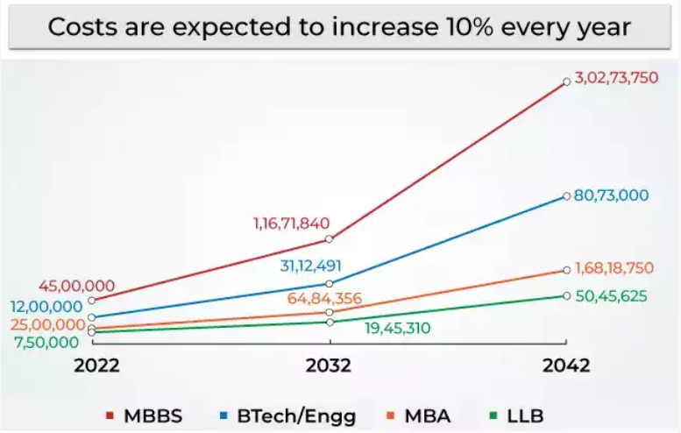
Children’s College Education Cost
Children’s Education is becoming expensive over the years. Our aspiration of type of education we want to provide to our children is more expensive than what we received.

Slide 13
Children’s Education Planning
Children’s education planning involve the following 4 key steps:
Time period of investment
Identify when do you need the corpus
Goal amount
Estimate how much amount you would need based on cost of education
Asset allocation
Identify your risk category and follow appropriate asset allocation
Savings requirement
Know the amount of monthly/annual savings required

Slide 14
Case Study
Chanchal Kumar is 30 years old, living in Delhi. He is earning 25 LPA and his wife is a home maker. They have single child, who is 2 years old. Chanchal wants to plan for kid’s education. He wants to provide quality education, and thinks he would need 30 Lakhs for kid’s higher education (in today Rs value) by the time Kid reaches 16 years age. He is an Balanced investor. How should Chanchal plan for this goal?

Slide 15
Case Study – Suggested Plan
Chanchal has 14 years for goal amount
Adjusting for 10% inflation, Chanchal would need 1.13 Crores
He is a balanced investor, he should invest 60% in equity, 40% in Debt
Gear 4 model portfolio has an average returns of 10.76%
Increase contribution towards the goal by 10% annually
Chanchal should save 2.25 Lakhs annually
Since this is one-time pay-out, Chanchal can withdraw total amount

Slide 16
Major factors – Children’s Education
Inflation – Educational costs have been increasing at a higher rate than the general inflation
Type of education – The costs vary dramatically based on type of education
Children details – Number of children and their current age will also impact the savings requirement

Slide 17
Templates used in this Episode
Gulaq Retirement Planning Template
Gulaq Children’s Education planning Template

Slide 18
Coming Episode
Refining investment style
Your Risk Tolerance
Liquidity Needs
Tax considerations

Slide 19
Thank You
FOLLOW US ON
Sandeep Tyagi
LinkedIn: https://www.linkedin.com/in/styagi/
Twitter: https://twitter.com/styagi
GULAQ
LinkedIn: https://www.linkedin.com/in/gulaqnew
Twitter: https://twitter.com/gulaqfintech
Instagram: https://www.instagram.com/gulaqfintech/

