Slide 1
Minimalist Art of Investing
Ep 4: Refining investment style
Sandeep Tyagi

Slide 2
Recap: First Three Episodes
Difficult to predict one year returns, easier to predict over long periods
On an average Sensex gave 11.4% returns (CAGR) over 10-years rolling returns
FD returns average is at 8.2%
60-40 model portfolio has 10.76% average returns
Savings rate of 25 to 40% is healthy
Investment Planning for 3 big goals: Retirement, Buying a home, children education
Templates provided on Gulaq.com:
Renting vs Buying
Retirement Planning
Childrens’ Education

Slide 3
OFFER FOR FREE CONSULTATION
Follow us on social media
Tag us
Make a request
FOLLOW US ON
Sandeep Tyagi
LinkedIn: https://www.linkedin.com/in/styagi/
Twitter: https://twitter.com/styagi
GULAQ
LinkedIn: https://www.linkedin.com/in/gulaqnew
Twitter: https://twitter.com/gulaqfintech
Instagram: https://www.instagram.com/gulaqfintech/

Slide 4
Liquidity Needs
The ability to convert investment into spendable cash is called Liquidity. Understanding when you need money is a crucial aspect in investment planning. This is called Liquidity need.
If you own a farm in a remote part of the country, it might be tough to sell and convert into cash. In this case, liquidity is very low.
Understanding the impact of cashing out investments when they are at a low value is equally important in assessing liquidity need.

Slide 5
Liquidity Needs – LTCM (1998) case study
Unravelling of a hedge fund - Long term capital management – in 1998 is a startling example of understanding the liquidity need.
LTCM was the shining star of financial world in most of 1990s
Noble laureates – Myron Scholes and Robert Merton were the principals of the firm
The fund had golden run for several years
In 1998, as Russia went through default, LTCM lost money
There were no buyers for securities held by LTCM
They continued to lose more and more money, and their securities couldn’t cover their losses
Finally, the fund got sold off to 14 banks
The owners – the smartest investors in the world – lost billions of dollars in this sale

Slide 6
Refining investment style
Most people view Risk as loss of principal. In investment world, risk is measured by uncertainty. Investments like FDs are reliable, but they give lower returns. Then there are other investments like Equities, with higher profits and higher uncertainty.
Risk appetite depends primarily on 2 factors
Your attitude towards uncertainty
Safety margin
Higher the savings, and longer the goal, higher the uncertainty you are comfortable with

Slide 7
Refining investment style – Driving analogy
Driving is very similar to investing. Some people drive fast, and others drive carefully. Driving behaviour can be explained using:
Your personality
Some people are comfortable driving fast, and don’t feel stressed keeping fully alert
Others are cautious, and not comfortable going high speeds
This thrill for speed or being cautious got nothing to do with the car or road conditions
Driving conditions
Drivers got to adjust to weather and road conditions – Even the speed loving ones
For ex: When it rains heavily, we tend to drive slowly. In open roads, we drive faster

Slide 8
Refining investment style – Driving analogy
Driving is very similar to investments. We need to assess investment situation and accordingly decide the risk and returns needed.
If we need money urgently or got just enough money, we can’t afford to take risks. We invest the money in FDs.
If the goals are distant, and we got good savings, then we can expect more growth by taking higher risk. Hence, we can invest in equities.
Your risk tolerance is a combination of your personality and market conditions. At Gulaq, we follow Gear-based investing.

Slide 9
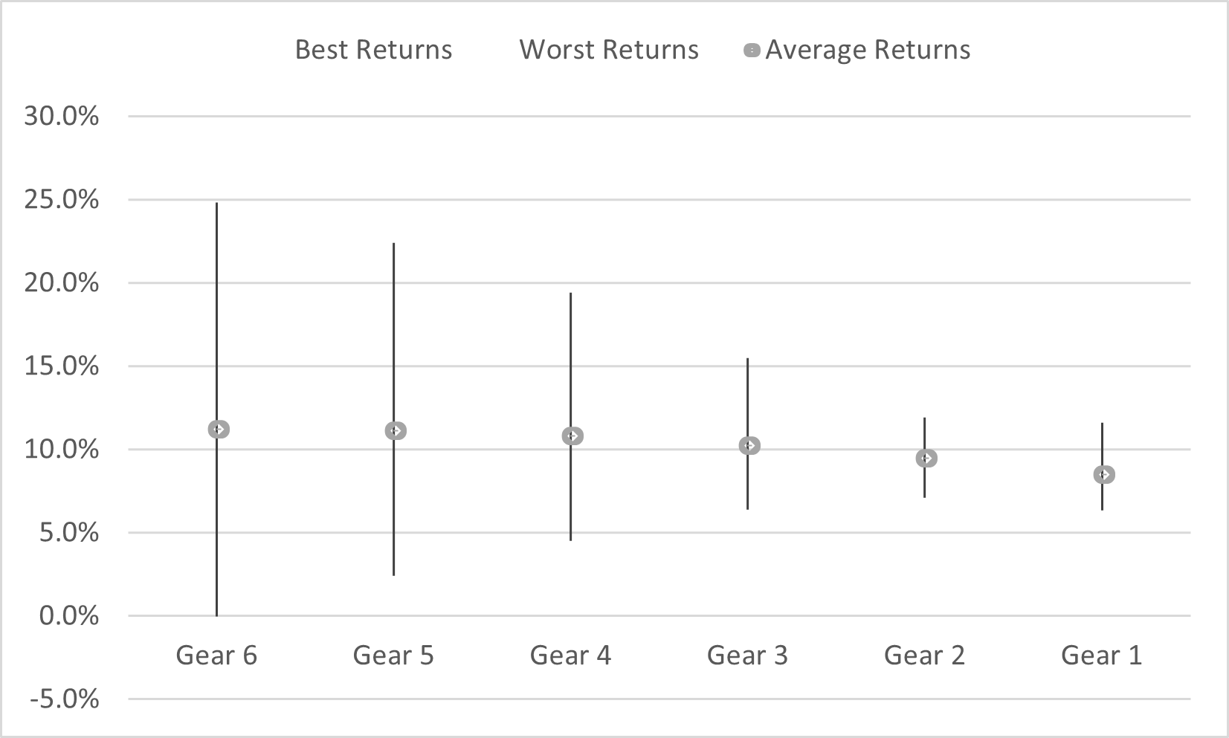
Gear based investing
 | Gear 6 | Gear 5 | Gear 4 | Gear 3 | Gear 2 | Gear 1
Equity | 100% | 80% | 60% | 40% | 20% | 0%
Debt | 0% | 20% | 40% | 60% | 80% | 100%
Average Returns | 11.2% | 11.1% | 10.76% | 10.16% | 9.29% | 8.2%
Notes:
https://www.macrotrends.net/countries/IND/india/life-expectancy#:~:text=The%20current%20life%20expectancy%20for,a%200.33%25%20increase%20from%202020.

Slide 10
Gear based investing
Which is your preferred investment gear?
Gear 6
Gear 5
Gear 4
Gear 3
Gear 2
Gear 1
Notes:
Average age of retirement in India is 58 to 63

Slide 11
Major factors - Risk Tolerance
Its not easy to know your risk tolerance. Hence, we have designed a Risk calculator on Gulaq.com. It’s a combination of the following factors:
Holding period of investment
Spending behaviour of investment
Income sources
Experience with Equity products
Investment objective
Behaviour in falling markets
Acceptable returns range

Slide 12
Risk Calculator – Know your risk appetite
Its not easy to know your risk tolerance. Hence, we designed a Risk calculator on Gulaq.com
Go to Gulaq.com
Risk calculator – under Tools section
Answer 7 basic questions about your investing behaviour
Know Your Risk appetite
Recommended Gear based investment portfolio
Start investing

Slide 13
Case Study
Chanchal Kumar has saved Rs. 9 Lakhs. He expects to buy a home and would require Rs. 10 Lakhs as downpayment in next 5 years. How should he assess the impact of his liquidity need on this savings plan?

Slide 14
Case study
Can Chanchal invest in Gear 5?
Yes, higher average returns makes it easier to reach goal
No, worst scenario is falling short of goal requirement
Liquidity assessment template provided on Gulaq.com
Notes:
Average age of retirement in India is 58 to 63

Slide 15
Gear based investing – 5 Year Rolling Returns
 | Gear 6 | Gear 5 | Gear 4 | Gear 3 | Gear 2 | Gear 1
Average Returns | 11.2% | 11.1% | 10.8% | 10.2% | 9.5% | 8.5%
Best Returns | 24.8% | 22.4% | 19.4% | 15.5% | 11.9% | 11.6%
Worst Returns | 0.0% | 2.4% | 4.5% | 6.4% | 7.1% | 6.3%
 | Gear 6 | Gear 5 | Gear 4 | Gear 3 | Gear 2 | Gear 1
Average | 15,31,641 | 15,24,768 | 15,02,939 | 14,65,340 | 14,14,229 | 13,51,421
Best outcome | 27,24,680 | 24,72,576 | 21,84,058 | 18,49,918 | 15,79,039 | 15,60,081
Worst outcome | 8,99,100 | 10,13,310 | 11,21,564 | 12,27,300 | 12,68,206 | 12,23,268
*Equity = BSE Sensex, Debt = FD Returns, 90% confidence
Notes:
https://www.macrotrends.net/countries/IND/india/life-expectancy#:~:text=The%20current%20life%20expectancy%20for,a%200.33%25%20increase%20from%202020.

Slide 16
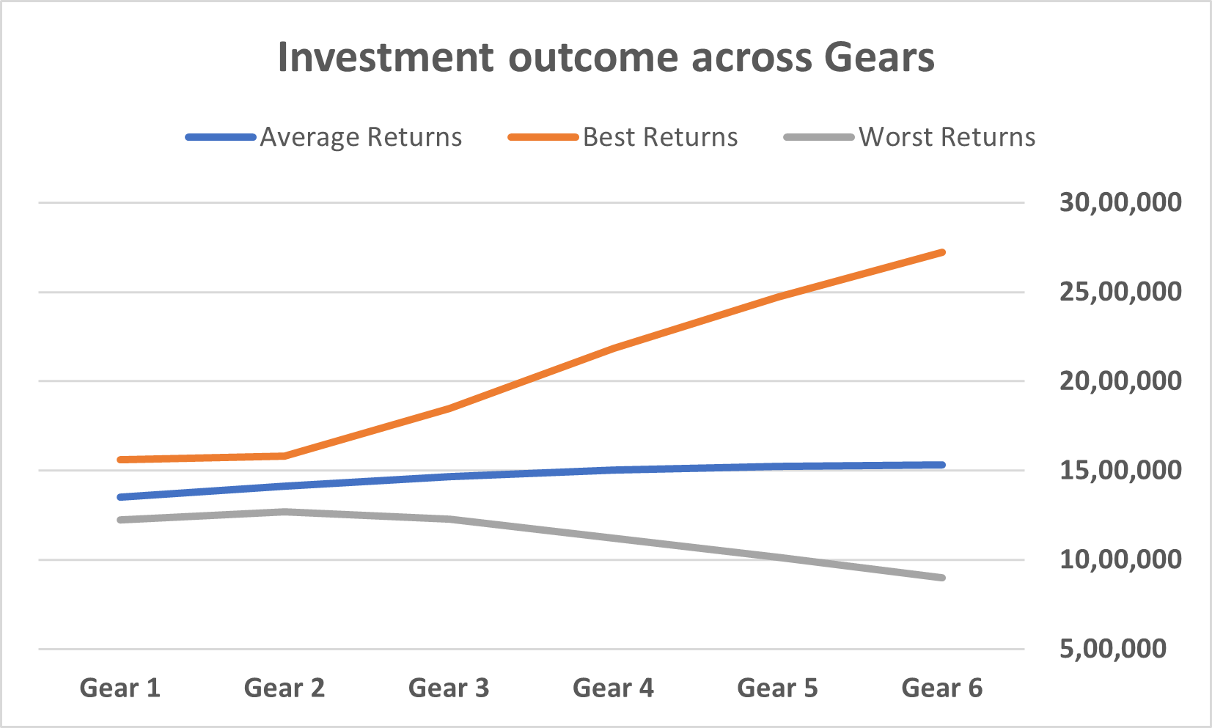
Gear based investing – 5 Year Rolling Returns
*Equity = BSE Sensex, Debt = FD Returns, 90% confidence
Notes:
https://www.macrotrends.net/countries/IND/india/life-expectancy#:~:text=The%20current%20life%20expectancy%20for,a%200.33%25%20increase%20from%202020.

Slide 17
Case Study
Chanchal has 9 Lakhs savings, and has a liquidity need of 10 Lakhs in 5 years
Average and best cases of all gears can help Chanchal reach his goal
If we look at worst cases
Gear 6 investment would make him fall short of the goal
Gear 1, 2, 3, 4, 5 investments will meet the liquidity need
As Gear 5 has higher expected return, Chanchal should invest in Gear 5 portfolio

Slide 18
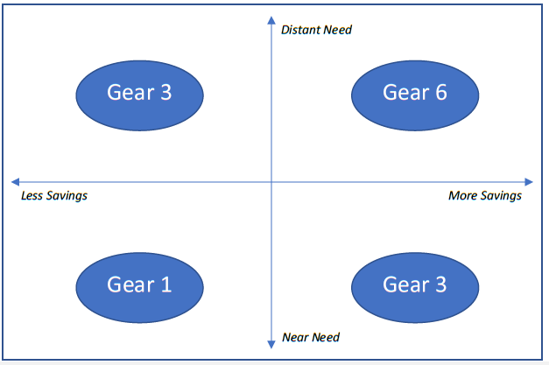
Gear based investing
Right level of risk depends on two factors:
Savings available
Goal time period
If you have larger savings compared to needs, sensible to take more risk
Excess return helps in additional return without missing on goals

Slide 19
Tools used in this Episode
Gulaq Risk Calculator
Gulaq Liquidity Assessment Template

Slide 20
Coming Episode
Asset Allocation

Slide 21
Thank You
FOLLOW US ON
Sandeep Tyagi
LinkedIn: https://www.linkedin.com/in/styagi/
Twitter: https://twitter.com/styagi
GULAQ
LinkedIn: https://www.linkedin.com/in/gulaqnew
Twitter: https://twitter.com/gulaqfintech
Instagram: https://www.instagram.com/gulaqfintech/

