Slide 1
Minimalist Art of Investing
Ep 5: Secret to Asset Allocation
Sandeep Tyagi

Slide 2
Recap: First Four Episodes
Difficult to predict one year returns, easier to predict over long periods
10 Year Rolling returns: Sensex gave 11.2% CAGR, FD gave 8.2% CAGR
60-40 model portfolio has 10.76% average returns
Savings rate of 25 to 40% is healthy
Investment Planning for 3 big goals (Templates provided on Gulaq.com):
Retirement Planning
Buying a home
children education
Gear based investing: Take risk survey and find out your risk appetite
Liquidity needs or goal target date has a significant impact on your asset allocation

Slide 3
OFFER FOR FREE CONSULTATION
Follow us on social media
Tag us
Make a request
FOLLOW US ON
Sandeep Tyagi
LinkedIn: https://www.linkedin.com/in/styagi/
Twitter: https://twitter.com/styagi
GULAQ
LinkedIn: https://www.linkedin.com/in/gulaqnew
Twitter: https://twitter.com/gulaqfintech
Instagram: https://www.instagram.com/gulaqfintech/

Slide 4
Secret to Asset Allocation
Risk
11.2%
Equity
8.2%
FD
Return
Notes:
Average age of retirement in India is 58 to 63

Slide 5
Secret to Asset Allocation
Asset Allocation of Gear 5 investment?
100% Equity
80% Equity, 20% Debt
60% Equity, 40% Debt
40% Equity, 60% Debt
Notes:
Average age of retirement in India is 58 to 63

Slide 6
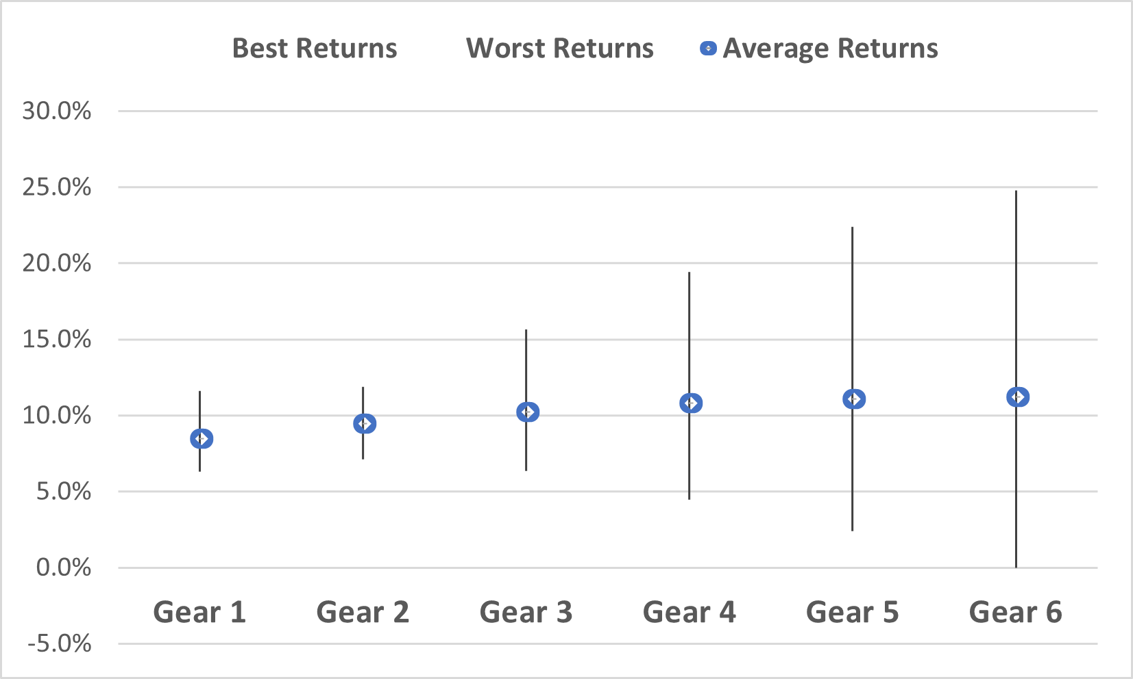
Secret to Asset Allocation
 | Gear 1 | Gear 2 | Gear 3 | Gear 4 | Gear 5 | Gear 6
Equity | 0% | 20% | 40% | 60% | 80% | 100%
Debt | 100% | 80% | 60% | 40% | 20% | 0%
Average Returns | 8.2% | 9.29% | 10.16% | 10.76% | 11.1% | 11.2%
Notes:
https://www.macrotrends.net/countries/IND/india/life-expectancy#:~:text=The%20current%20life%20expectancy%20for,a%200.33%25%20increase%20from%202020.

Slide 7
Asset Allocation - Fixed Income
Selecting right gear is a major step in asset allocation. You can get any gear by mixing only 2 ingredients: Fixed income and Equity.
Duration of investment and Returns are “FIXED” upfront in Fixed income securities.
Bank Deposits
Banks are regulated by Reserve bank of India, hence very safe
Mutual Funds
The fund holds different types of fixed income securities
Debt instruments
Can be issued by public or private companies—Bharat Bond, corporate bonds
Credit risk is important to understand

Slide 8
Fixed Income – Credit Risk
Credit Risk refers to the ability of borrower of not being able to repay the debt. Higher the credit risk, higher should be the returns.
Govt and Banks:
Fixed income securities offered are considered safe
Lower returns, Lower risk
Private Entities:
Higher risk, as the repaying ability depends on business context
Investors are compensated with higher returns
The other risk involved is term of the investment (Lock-in period). Should be factor in investment planning

Slide 9
Asset Allocation: Indian Equities
Stock market is the primary source of investment growth for investors
Equity investing → Buying a small part of a large business
Profits & future growth is owned by shareholders of the company
Equity investments are made through brokerage accounts
One can invest in those companies which are registered on exchange through IPO
Once the shares are public, they are allowed to buy or sell by investors
This mechanism allows investors to own a small piece of business they like

Slide 10
Indian Equities – Return components
Equity investment generates two types of returns
Dividends: Amount of money business pays shareholders at regular intervals
Share price growth: Growth of business prospects over time
Dividend generally varies from 2% to 5% of share price
Share price growth forms the larger part of investors’ profit over time
Stock Group | Nifty 50
Time period | Jan 1, 2012 to Dec 31, 2022
Total Return | 247%
Dividend Return | 40%
Stock Price Return | 207%

Slide 11
Tax considerations
Asset | Short Term | Long Term
Equity (Domestic, Foreign, Mutual Funds, Shares) | 15% ( Less than 1 Year) | 10% ( >1 Year) Up to 1 Lakh profit is Tax free
Listed Debt instruments | Regular income tax slab (<1 year) | 10% without indexation (>1 year)
Unlisted Debt instruments | Regular income tax slab (<3 years) | 20% without indexation (>3 years)
Real Estate | Regular income tax slab (Less than 2 years) | 20% with indexation ( >2 years)

Slide 12
Tax considerations – Case study
Chanchal Kumar, Manoj Kumar, and Parvat Kumar friends. Chanchal Kumar trades every month, Manoj Kumar trades once a year, and Parvat Kumar is the slowest of all. He holds the same security for 10 years. All of them have 100 to start with, investment yield is 15%, and cost of transaction are 0.05%. How much difference will it make after 10 years?

Slide 13
Tax considerations – Case study
Holding period for Equity investments for Long Term capital Gains Tax?
>1 Year
> 2 Years
>3 Years
Notes:
Option A

Slide 14
Tax considerations – Case study
Chanchal:
As shown earlier, tax slab of 15% as holding period is short term
Chanchal’s 100 will grow to 335
Manoj Kumar:
Manoj will be in 10% tax slab, as holding period is 1 year
100 will grow to 353, 18% more than Chanchal’s
Parvat Kumar:
Parvat will be in 10% tax slab, as holding period is >= 1 year
100 will grow to 372, 19% more than Manoj’s
The difference is due to different tax slabs and delay in taxation. You get to earn return on the part of tax that you have not yet paid.

Slide 15
Other Assets: Real Estate
Real Estate is not part of our model portfolio due to 3 reasons:
Liquidity risk: Ability to convert investment into cash depends on market sentiment
Diversification risk: Due to huge investment, many investors won’t be able to invest in many real estate properties
Relative attractiveness of Renting over Buying
However, Home ownership is a goal for many as a lifestyle choice. If that’s the case for you, better account for this in your investment planning.

Slide 16
Other Assets: Real Estate - REITS
We expect that real estate investments will become more attractive as REITS scale up. REITS are making real estate participation for retail investors smooth.
REITS can be seen as a mutual fund for real estate investments
Fund manager buys many real estate properties
Investors can buy a small share of this portfolio
REITs address 2 major risks of real estate investment
Liquidity
Diversification
Investments in REITs can be made through stock exchange and mutual funds

Slide 17
Other Assets: Foreign Equity
Indian Equity represents less than 5% of Global business
There are several factors which impact Indian equity: Politics, Macro economics, etc.
Investing in foreign equity helps in diversifying beyond India specific risk
United States is world’s largest market, with iconic brands listed (Apple, Google, Amazon, etc.)
Investments can be made in two ways:
Direct investing: Open trading with foreign brokers, or with domestic brokers who has Tie-ups with foreign stock brokers
Indirect investing: Through mutual funds, ETFs, etc.
Under Liberalized Remittance scheme, Indians can invest $2,50,000 per year in US equities

Slide 18
Other Assets: Gold
A Traditional investment. Indians are the largest buyers of Gold worldwide. In 2022 alone, Indian consumers bought 774 tonnes of Gold worth INR 41,390 crore, down 3% from 2021
Gold has preserved, and for most of the time, increased its value
Produced a CAGR of 9.5% over last 30 years (in INR)
However, Gold as an investment has two major shortcomings
Unlike Equity investment in a business, Gold is not a productive Asset
It does not have predictable return pattern
It is not a good hedge against inflation
Gold is neither a productive asset which grows over time nor a fixed security with committed return

Slide 19
Other Assets: Gold
Gold is a good investment, because
Good hedge against Inflation
Produces good returns, relative to Equity

Slide 20
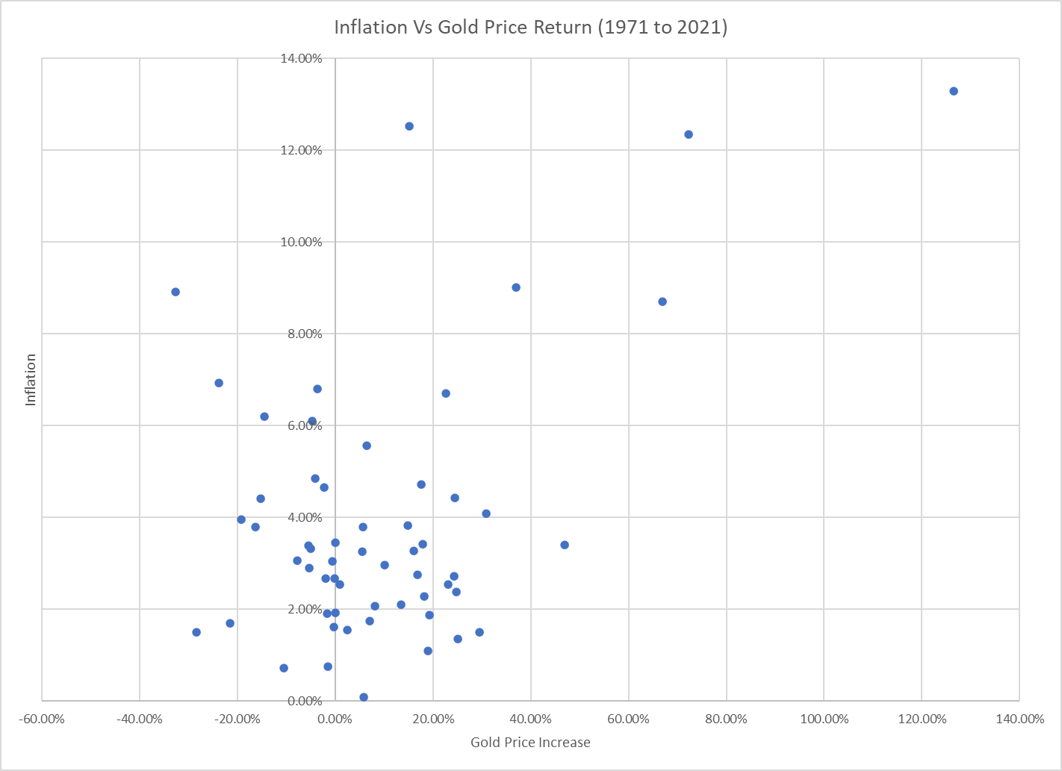
Other Assets: Gold

Slide 21
Other Assets: Crypto
Crypto is based on blockchain technology. It creates system which allows exchange of money without any trusted party in the middle. This revolutionary technology has wide range of applications which can be potentially built over coming decades.
The potential for higher profits has attracted many young investors
However, there is a lot of uncertainty in predicting crypto winners
The regulations around crypto are also not clear
The underdeveloped institutions which provide access to crypto are also not regulated
In 2005, Mt. Gox was the largest exchange which lost lot of money due to security issues
Similarly in 2022, FTX being the large exchange declared bankruptcy
We recommend retail investors to stay away from crypto, till the regulations get clear.

Slide 22
Other Assets: Insurance
Insurance products are designed to overcome risks that individual investor can’t overcome. The younger the person, the more insurance they need to carry. Thumb rule is insured amount should be equal to the current value of savings over their career. Insurance covers primarily 3 risks:
Health:
Huge healthcare costs can ruin financial life of investors
Cost of treatment is high, though the chance of needing treatment is low
Early death of earning member:
Every family has a earning member, who earns more and takes care of family’s needs
In case of untimely death of such member, insurance protects the dependents
Risk of uncertainty during retirement years:
Likely to happen if planned life expectancy is lower than actual lifetime

Slide 23
Other Assets: Annuity
We plan for retirement keeping certain life expectancy in mind. However, there is a risk of uncertainty if the actual life time exceeds the planned life expectancy.
An annuity is a combination of insurance and investment product
It protects against how long one needs retirement savings
Annuity product bridges the gap between those whose actual life time is shorter than planned, and those whose actual life time is more than planned one.
So, everyone receives the same amount of return every year

Slide 24
Other Assets: NPS and PPF
Tax efficient investment products provided by Indian Govt.
NPS | PPF
Allows stock market investing though NPS managed schemes | PPF provides fixed returns
Maturity – 60 years of Age | Maturity – Upon retirement
Returns → 10 to 12% (in long term) | Returns → 7 to 8% (historical)
At maturity, 60% of the corpus can be withdrawn. Full Tax exempted. 40% is used to buy annuity, the income on annuity is taxable. | Fully Tax exempted
Invest up to 2 Lakhs per year | Invest up to 1.5 Lakhs per year

Slide 25
Coming Episode
Active vs Passive investing

Slide 26
Thank You
FOLLOW US ON
Sandeep Tyagi
LinkedIn: https://www.linkedin.com/in/styagi/
Twitter: https://twitter.com/styagi
GULAQ
LinkedIn: https://www.linkedin.com/in/gulaqnew
Twitter: https://twitter.com/gulaqfintech
Instagram: https://www.instagram.com/gulaqfintech/

