Slide 1
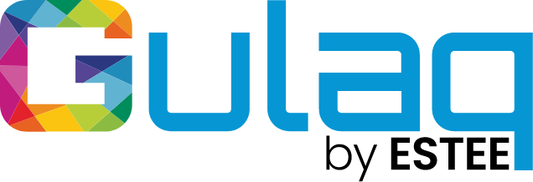
Minimalist Art of Investing
Ep 6: Active vs Passive investing
Sandeep Tyagi

Slide 2
Recap: First Five Episodes
Difficult to predict one year returns, easier to predict over long periods
10 Year Rolling returns: Sensex gave 11.2% CAGR, FD gave 8.2% CAGR
60-40 model portfolio has 10.76% average returns
Savings rate of 25 to 40% is healthy
Investment Planning for 3 big goals (Templates provided on Gulaq.com):
Retirement Planning
Buying a home
children education
Gear based investing: Take risk survey and find out your risk appetite
Liquidity needs or goal target date has a significant impact on your asset allocation
Get any gear by mixing only two ingredients: Equity and Fixed income

Slide 3
OFFER FOR FREE CONSULTATION
Follow us on social media
Tag us
Make a request
FOLLOW US ON
Sandeep Tyagi
LinkedIn: https://www.linkedin.com/in/styagi/
Twitter: https://twitter.com/styagi
GULAQ
LinkedIn: https://www.linkedin.com/in/gulaqnew
Twitter: https://twitter.com/gulaqfintech
Instagram: https://www.instagram.com/gulaqfintech/

Slide 4
Active vs Passive investing
The biggest difference between passive and active investing is that active investing involves picking selective investments with an objective to beat index, whereas passive investing typically tracks an index.
Notes:
Average age of retirement in India is 58 to 63

Slide 5
Passive investing
Passive investors aim to earn market average returns. They assume its tough to beat the average, hence would prefer investing in index.
Cost of passive investing is low compared to active investing
Active managers charge fee, which is low/none in passive investing
The cost in terms of Time and efforts required is also low in passive investing
“After the deduction of the costs of investing, beating the stock market is a loser’s game.”
- John Bogle, Founder of Vanguard Group
Notes:
Average age of retirement in India is 58 to 63

Slide 6
Active Investing
If you believe that you or your advisor is better than the average investor, active investing makes sense.
Alpha generation is the primary objective of active investing
In Active investing, fund managers picks a set of investments
Based on performance, fund managers regularly updates portfolio to optimise returns
Since it involves active efforts of fund manager, active investing is expensive
Risk is higher – Fund manager tries to beat the benchmark, and all can’t do that
Notes:
Average age of retirement in India is 58 to 63

Slide 7
Active vs Passive investing
Which investing style would you prefer?
Active
Passive
Mix of both
Notes:
Average age of retirement in India is 58 to 63

Slide 8
Active Investing
Analysis of Profit and Loss of Individual Traders dealing in Equity F&O Segment
--Published Jan 25, 2023 (available on their website)
 | FY19 | FY22
Total No. of individual traders (sample) | 7,06,757 | 45,24,841
% of Total | 100% | 100%
% of Loss makers during the year | 85% | 89%
% of Profit makers during the year | 15% | 11%
This does not even include transaction costs. The numbers are worse (maybe half with that)
Loss makers made INR 1.1 L loss
Profit makers (11% of total) made INR 1.78 L in profit
Does this seem like a gamble you would want to take?
Notes:
Average age of retirement in India is 58 to 63

Slide 9
Active Investing – The Bet
If you think professional fund managers can help you beat market, we got an interesting case of Protégé Partners, a fund of funds, whose job it is to find sophisticated hedge funds to invest in.
Warren Buffet famously bet against Protégé Partners in 2008
The bet is S&P 500 will outperform the investment in 5 selected funds by Protégé Partners in next decade
During the bet period, the group of hedge funds made 22.4% returns vs S&P 500’s 85.4%
The group of hedge funds outperformed index only 2 out of 10 years
On the other hand, Warren Buffet himself is an active investor. He outperformed S&P 500 regularly, and produced 2X returns compared to S&P 500 from 1965 to 2021.
Notes:
Average age of retirement in India is 58 to 63

Slide 10
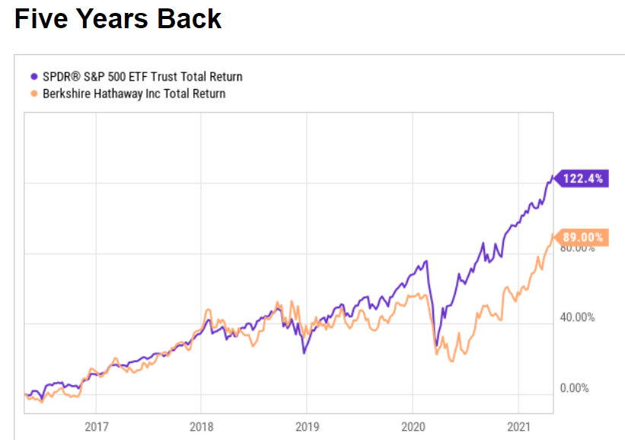
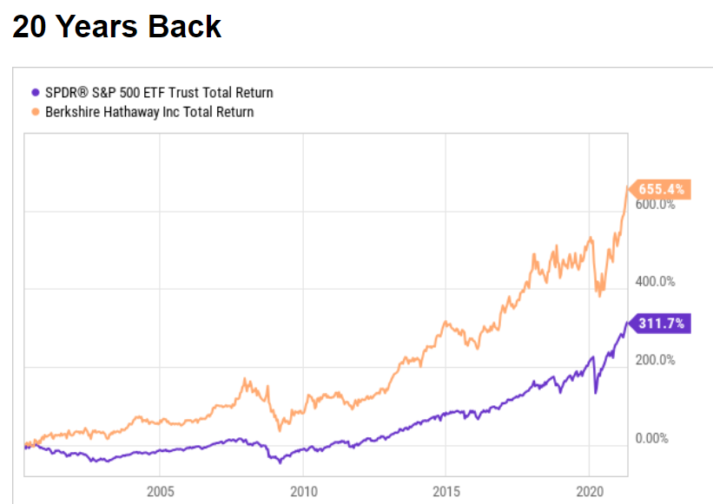
Active Investing – Patience and Conviction
Berkshire outperformed S&P by more than 100% over 20 years period, but underperformed in 5-year period (2016 – 2021)
*Source: Seeking Alpha, Period: 2001-2021

Slide 11
Investment Needed
Teams or investors who can generate ALPHA spend a lot to get there
Estee has 135 employees—many with IIT, IIM or foreign degrees
Estee has over 100 servers, and access to 1000’s of machines in Google cloud
Estee spends nearly INR 2 Crore buying and managing data
Yes, with that, we can produce alpha over the index!
Notes:
Average age of retirement in India is 58 to 63

Slide 12
Evaluating Active Fund managers
Percentage of Indian Active Equity large cap funds failed to beat benchmark over last 3 years?
89%
64%
51%
36%
Notes:
Answer: 89%

Slide 13
Evaluating Active Fund managers
*Source: SPIVA, Data as on 12/31/2022

Slide 14
Evaluating Active Fund managers
Benchmark performance
Costs
Volatility
At Gulaq, we have 6 Gear based portfolios with different asset allocation. Each portfolio has unique risk to reward ratio, to serve wide range of investor categories.

Slide 15
Evaluating Active Fund managers - Costs
Types of costs involved: Advisory fee, Brokerage fee, Admin fee, etc.,
Fees, Transaction costs eat up large part of returns over long term
Have a rough idea about how much % of AUM is your fee
Returns should be higher than benchmark returns + fees %
An average large-cap mutual fund has a total expense ratio of 2.15%
Expense ratio range of Large-cap mutual funds → 1.54% to 2.67%
For index funds, expense ratio is as low as 0.06%

Slide 16
Evaluating Active Fund managers - Volatility
Typically funds with good recent performance only advertise their recent performance
Hence, its recommended to see the historical performance for mid to long term
For Equity funds, at least investors should look at 3 years returns
Additionally, check how the fund has performed in different market cycles
Funds which are based on single factor models, tend to outperform market in favourable conditions, and underperform in other conditions
Same is the case with a specific theme based or sector based funds

Slide 17
Active vs Passive – Which suits better?
Active or Passive investing are two different investment styles. The following are some traits we can attribute to these two investing styles.
 | Active Investing | Passive Investing
Objective | Beat Markets | Grow with Markets
Risk | High | Low
Returns | Can be High | Medium
Efforts Required | Very High | Low
Costs | High | Low
Diversification | Medium | High
Attitude | Aim for the best | Slow & Steady

Slide 18
Coming Episode
Avoiding Noise
Emotions of investing
Technical Indicators
Sector or Factor Investing

Slide 19
Thank You
FOLLOW US ON
Sandeep Tyagi
LinkedIn: https://www.linkedin.com/in/styagi/
Twitter: https://twitter.com/styagi
GULAQ
LinkedIn: https://www.linkedin.com/in/gulaqnew
Twitter: https://twitter.com/gulaqfintech
Instagram: https://www.instagram.com/gulaqfintech/

