Slide 1
Minimalist Art of Investing
Ep 7: Avoiding Noise
Sandeep Tyagi

Slide 2
Recap: First Six Episodes
Difficult to predict one year returns, easier to predict over long periods
10 Year Rolling returns: Sensex gave 11.2% CAGR, FD gave 8.2% CAGR
60-40 model portfolio has 10.76% average returns
Savings rate of 25 to 40% is healthy
Investment Planning for 3 big goals (Templates provided on Gulaq.com):
Retirement Planning
Buying a home
children education
Gear based investing: Take risk survey and find out your risk appetite
Get any gear by mixing only two ingredients: Equity and Fixed income
Active vs Passive investing: Figure out what kind of investor you are

Slide 3
OFFER FOR FREE CONSULTATION
Follow us on social media
Tag us
Make a request
FOLLOW US ON
Sandeep Tyagi
LinkedIn: https://www.linkedin.com/in/styagi/
Twitter: https://twitter.com/styagi
GULAQ
LinkedIn: https://www.linkedin.com/in/gulaqnew
Twitter: https://twitter.com/gulaqfintech
Instagram: https://www.instagram.com/gulaqfintech/

Slide 4
What is Noise?
The major problem with disciplined investing lies in implementation. Investors get distracted by emotional aspects, tons of information availability on fingertips, etc.
Internal noise
External noise
Notes:
Average age of retirement in India is 58 to 63

Slide 5
Emotional Roller-coaster
We have met the enemy and he is us
- Walt Kelly
Notes:
Average age of retirement in India is 58 to 63

Slide 6
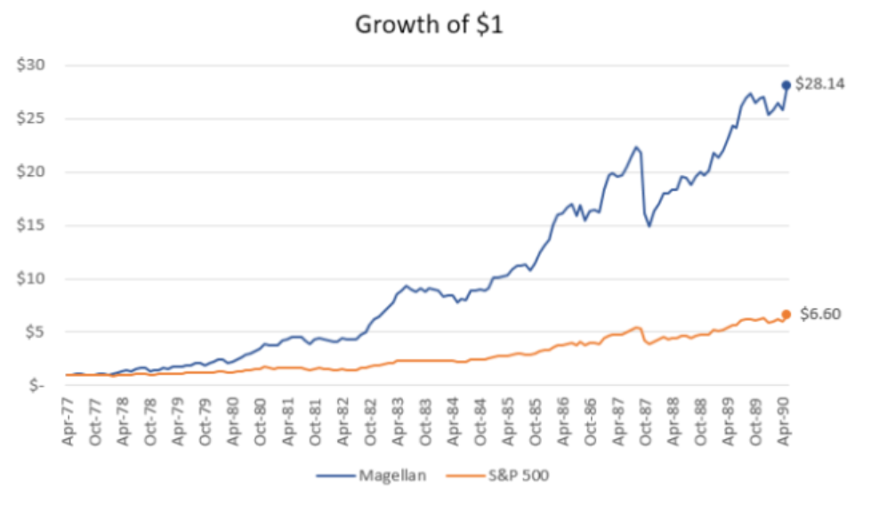
How Noise impacts returns?
Peter Lynch managed Magellan Fund from 1977 to 1990, which had $18 million in assets when he started, had grown to $14 billion by the time he resigned as the fund manager.
Fund returns 29% CAGR
According to Fidelity investments, the average Magellan fund investor lost money during Lynch’s tenure.
These investors underperformance is poor investment decisions driven by Noise.
*Source: Quantified strategies
Notes:
Average age of retirement in India is 58 to 63

Slide 7
Avoiding Noise - Emotions
You have invested in a stock at Rs. 100. You are expecting it to grow to 110 in one year. After 3 months, the stock is down to Rs. 90. What will you do?
My stock picking is bad, I will exit at 90
I will wait till I recover loss, will exit at 100
Stock is cheap now, let me buy more
Do nothing
Notes:
Average age of retirement in India is 58 to 63

Slide 8
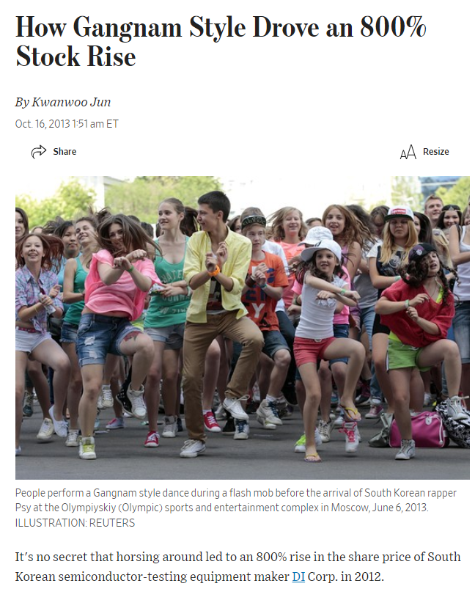
Avoiding Noise - Availability
Over emphasize on things that are readily available in our memory
Gangnam style song release drive 800% increase in stock price of DI Corp
The only link is DI Corp was led by the father of singer Psy
Same is the case with huge popularity behind FAANG share prices
Notes:
Average age of retirement in India is 58 to 63

Slide 9
Avoiding Noise – Loss Aversion
Pain from Rs. 100 Loss
People tend to fear a loss twice as much as they are likely to welcome an equivalent gain
- Daniel Kahneman
Pleasure from Rs. 100 Gain
Notes:
Average age of retirement in India is 58 to 63

Slide 10
Avoiding Noise – Loss Aversion
I shouldn’t have withdrawn my investment. Is it a good time to invest?
Stock is rallying. Invested.
Thank god, I recovered my loss. I exit.
Read about a stock. Lets track it for a while.
Seems like stock is not a good buy, I will wait till I recover my loss.
Notes:
Average age of retirement in India is 58 to 63

Slide 11
Avoiding Noise – Loss Aversion
Loss aversion plays a key role in investing. People keep on holding their losing investments for much longer than they would otherwise. Chanchal and Parvat are brothers. They discuss about their stock investments regularly. The following is a scenario they have gone through loss aversion bias:
Chanchal
Parvat
Bought the stock at Rs. 100
After a few days, stock gone down to 90
Feels the stock is not a good buy
Doesn’t want to sell, till he recovers loss
Planned to Buy the stock at Rs. 100, but forgot
After a few days, stock gone down to 90
Got nervous, and felt the stock is not a good buy
So, he didn’t buy
Notes:
Average age of retirement in India is 58 to 63

Slide 12
Chart indicators
Newspapers, popular financial websites, social media platforms, even TikTok is filled with stock market advice.
There were 100s of technical analysis articles published on popular financial platforms
Proponents of chart indicators say that emotions drive markets and creates patterns
They believe these chart patterns help in predicting market movement
Ex: Golden Cross, Double Bottoms, etc.
Can these technical indicators pattern help in predicting the stock market movement?
Notes:
Average age of retirement in India is 58 to 63

Slide 13
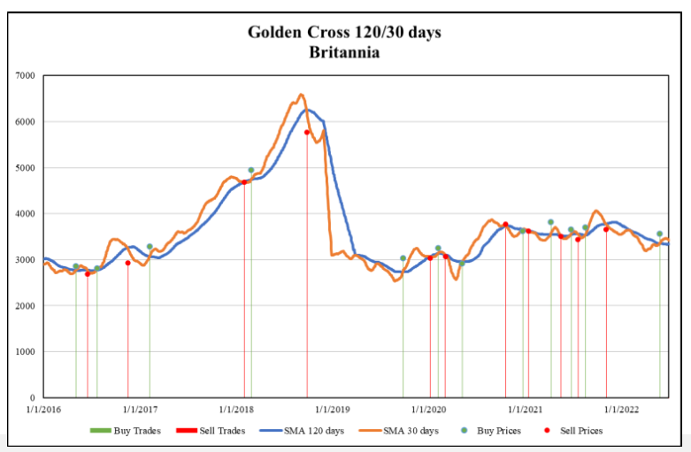
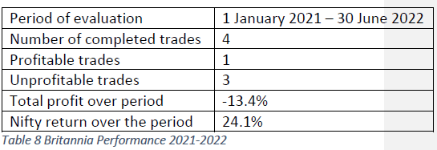
Chart indicators – Golden cross
Golden cross occurs when a short-term indicator crosses a long-term trend. Ex: Simple moving average
Notes:
Average age of retirement in India is 58 to 63

Slide 14
Chart indicators – Golden cross
We examined Golden cross across Nifty 50 securities. The following are the results during the period Jan 1, 2016, to June 30, 2022. Every time the market exhibited Golden cross, we took long position, and reversed when the reverse happened.
Period of Evaluation | 1/1/2016 – 30/06/2022
Number of completed Trades | 514
Profitable Trades | 205
Unprofitable Trades | 309
Total profit over period | 35%
Nifty return over the period | 108%
*Nifty 50 securities Golden Cross Trades
Notes:
Average age of retirement in India is 58 to 63

Slide 15
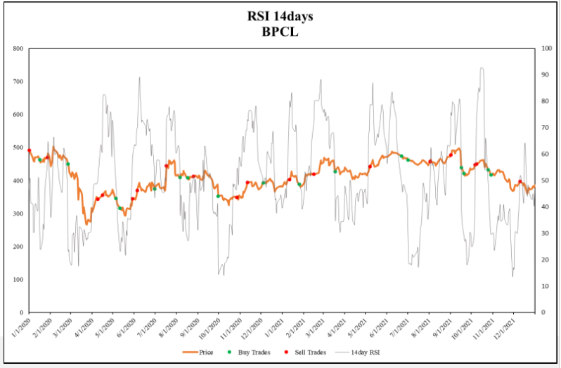
Chart indicators – Relative Strength indicator (RSI)
RSI is a momentum indicator, uses average profit of periods with price increase and decrease in recent past to determine whether the stock is overbought or oversold. In this analysis we used 30% cutoff for buy signal and 70% for a sell.
Period of Evaluation | Jan 2016 – June 2022
Number of completed Trades | 45
Profitable Trades | 25
Unprofitable Trades | 20
Total profit over period | -22.5%
Nifty return over the period | 108%
*Nifty 50 securities RSI Trades
Notes:
Average age of retirement in India is 58 to 63

Slide 16
Chart indicators - Conclusion
A technical indicator which relies on price and volume information alone does not produce good returns.
There are 300+ factors which are identified for technical analysis.
It’s waste of time, spending time on these simple charts, indicators, etc.,
Notes:
Average age of retirement in India is 58 to 63

Slide 17
Chart indicators
Bollinger Bands
Candlestick patterns
Golden Cross
Exponential moving averages
Relative strength index
Linear Regression
MACD Oscillator
Momentum
Value
Growth
Low volatility
Moving Average
Negative Volume
Price Volume Trend
Simple moving average
Stochastic oscillator
Stochastic RSI
Accumulation Distribution
ADX
Chaikin Oscillator
Directional Movement
Displaced Moving Average
Fibonacci Extensions
MACD Percentage
Median Price
Multiple Moving Averages
Percentage Bands
Price Ratio
TRIX Indicator
*Source: Incrediblecharts.com
Notes:
Average age of retirement in India is 58 to 63

Slide 18
Coming Episode
Avoiding Noise – Part II
Sectoral investing
Market Timing

Slide 19
Thank You
FOLLOW US ON
Sandeep Tyagi
LinkedIn: https://www.linkedin.com/in/styagi/
Twitter: https://twitter.com/styagi
GULAQ
LinkedIn: https://www.linkedin.com/in/gulaqnew
Twitter: https://twitter.com/gulaqfintech
Instagram: https://www.instagram.com/gulaqfintech/

