Slide 1
Minimalist Art of Investing
Ep 8: Avoiding Noise - II
Sandeep Tyagi

Slide 2
Recap: First Six Episodes
Difficult to predict one year returns, easier to predict over long periods
10 Year Rolling returns: Sensex gave 11.2% CAGR, FD gave 8.2% CAGR
60-40 model portfolio has 10.76% average returns
Savings rate of 25 to 40% is healthy
Investment Planning for 3 big goals (Templates provided on Gulaq.com):
Retirement Planning
Buying a home
children education
Gear based investing: Take risk survey and find out your risk appetite
Get any gear by mixing only two ingredients: Equity and Fixed income
Active vs Passive investing: Figure out what kind of investor you are
The hardest thing about investment is managing your emotions—greed and fear

Slide 3
OFFER FOR FREE CONSULTATION
Follow us on social media
Tag us
Make a request
FOLLOW US ON
Sandeep Tyagi
LinkedIn: https://www.linkedin.com/in/styagi/
Twitter: https://twitter.com/styagi
GULAQ
LinkedIn: https://www.linkedin.com/in/gulaqnew
Twitter: https://twitter.com/gulaqfintech
Instagram: https://www.instagram.com/gulaqfintech/

Slide 4
Thematic investing: Flavor of the month
Thematic investing refers to selecting a specific theme to invest. It aims to identify trends based on macro-economic factors, and benefit from the materialization of those trends.
Green Energy
Electric vehicles
Demand for IT MNCs
Housing boom
Rural Banking
Medical Tech
Growing middle class
Gaming
Exports
Notes:
If possible paste a few headlines from newspapers or magazines. Maybe Dalal Street covers,

Slide 5
Thematic investing: Challenges
Consistent high efforts required
Specialized knowledge and need to track regularly
Themes go in cycles
Too many themes to track

Slide 6
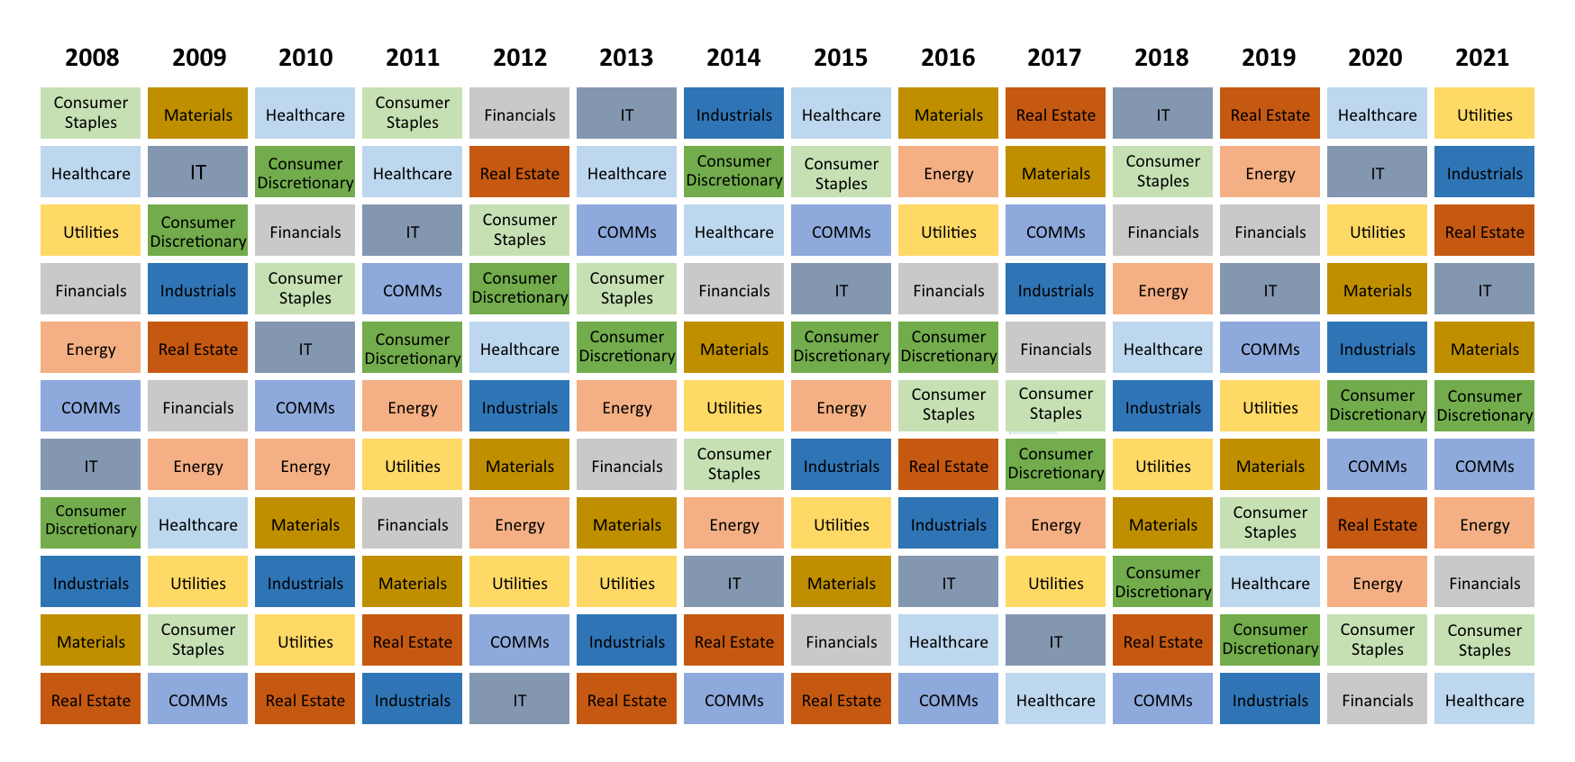
Sectoral investing

Slide 7
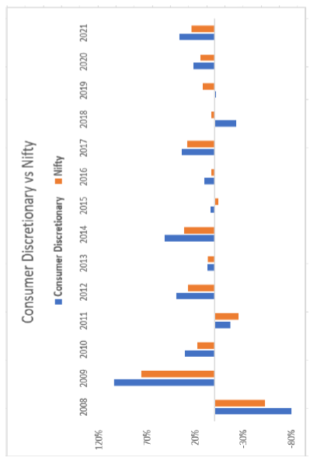
Sectoral investing
India had growing middle class in last decade
Consumer discretionary was expected to do well
However, the historical data suggests its not that straight forward—10 good years, 3 bad

Slide 8
Single factor investing
Single factor investing also falls under thematic investing
Factor investing refers to picking stocks based on specific attributes
Common factors: Momentum, value, quality, growth, volatility, and yield
Investment advisors design portfolios selecting stocks based on a popular factor

Slide 9
Single factor investing - Momentum
Momentum is a popular factor used by investment advisors
Momentum like all other thematic investments doesn’t work all the time
Momentum underperformed the index 7 out of 14 years

Slide 10
Thematic investing - Conclusion
Thematic or sector or factor investing is still better than stock picking
However, over the time thematic investing tend to underperform the index
For a common investor, thematic investing requires high efforts
We recommend a diversified portfolio which is sector/theme agonistic

Slide 11
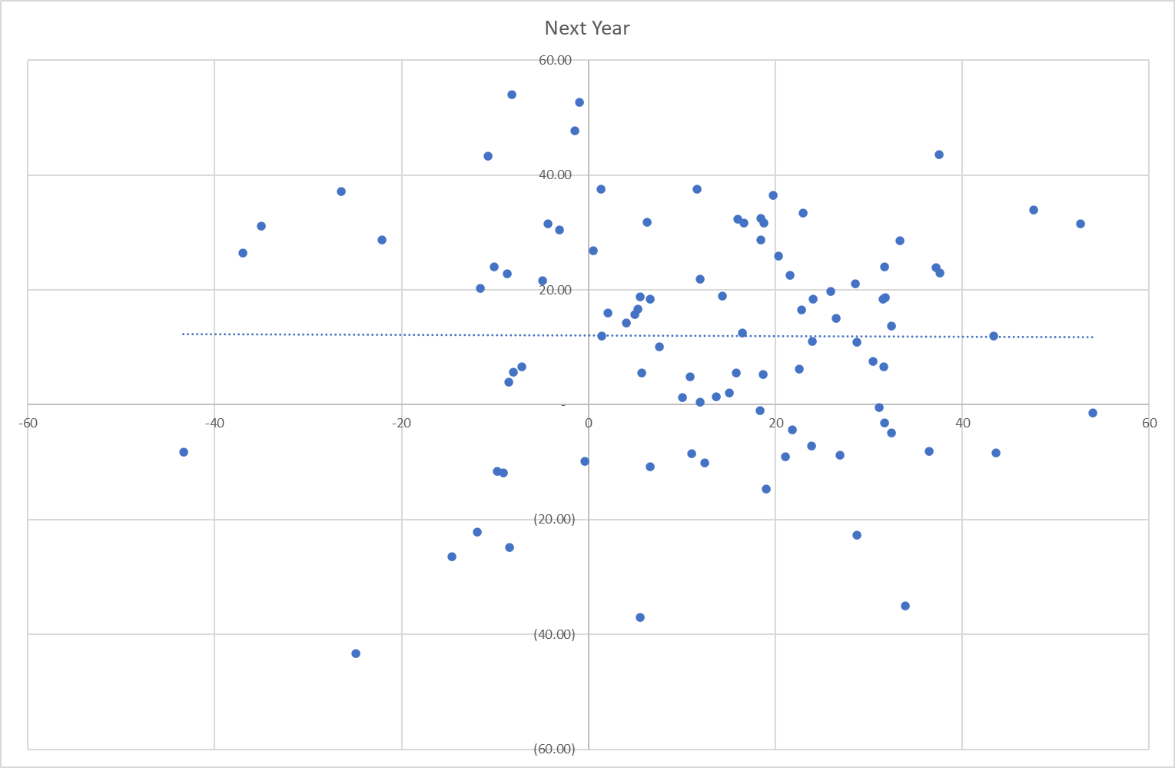
Market Timing
Market Timing is the hardest noise to ignore
S&P 500 current return vs Next year return
Left to right, current year returns
Top to bottom, next year returns
The flat trendline indicates extremely weak correlation
*Period considered: 1926 - 2022

Slide 12
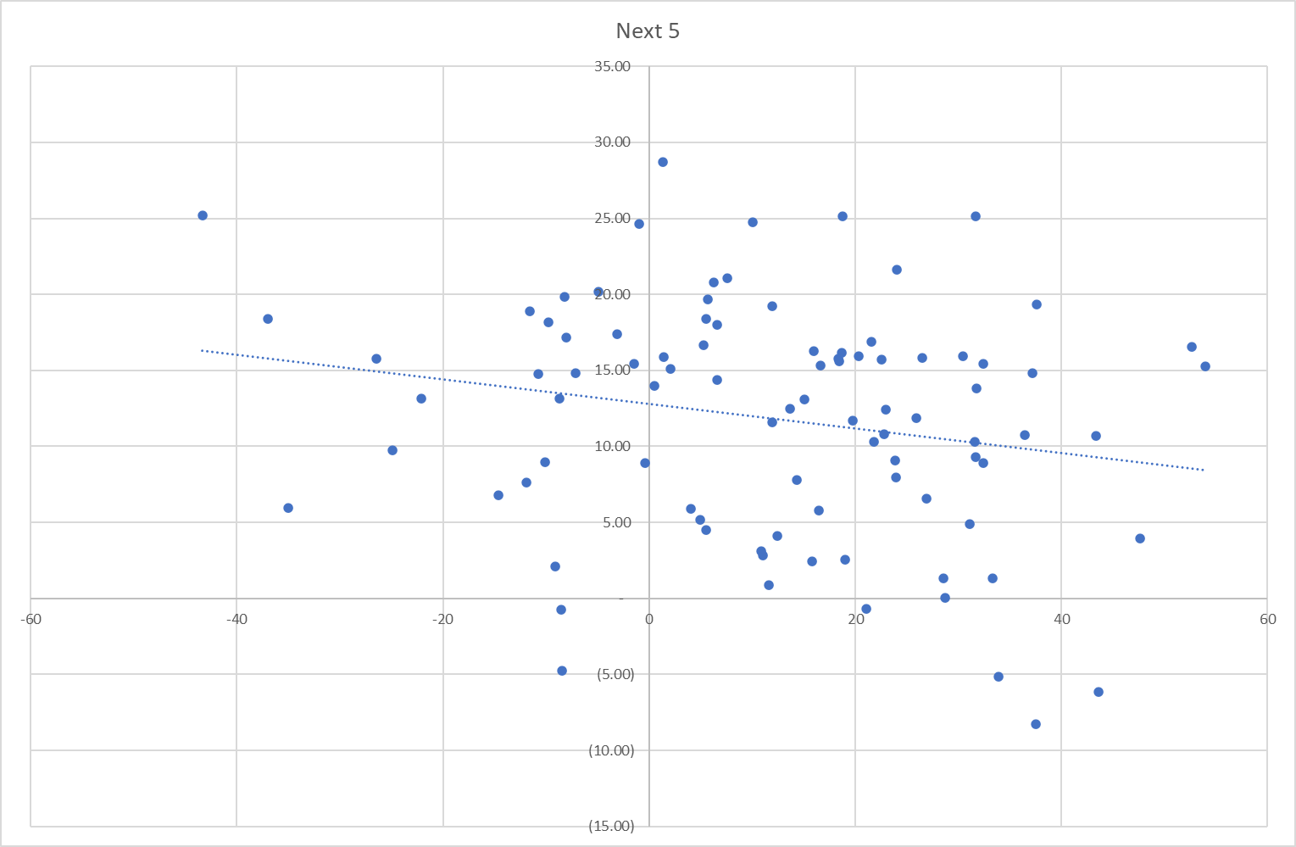
Market Timing – Current vs Next 5 years returns
S&P 500 current return vs Next 5 - years returns
Left to right, current year returns
Top to bottom, next 5 - years returns
Negative trendline is observed
Poor returns in current year means better returns in next 5 years
*Period considered: 1926 - 2022

Slide 13
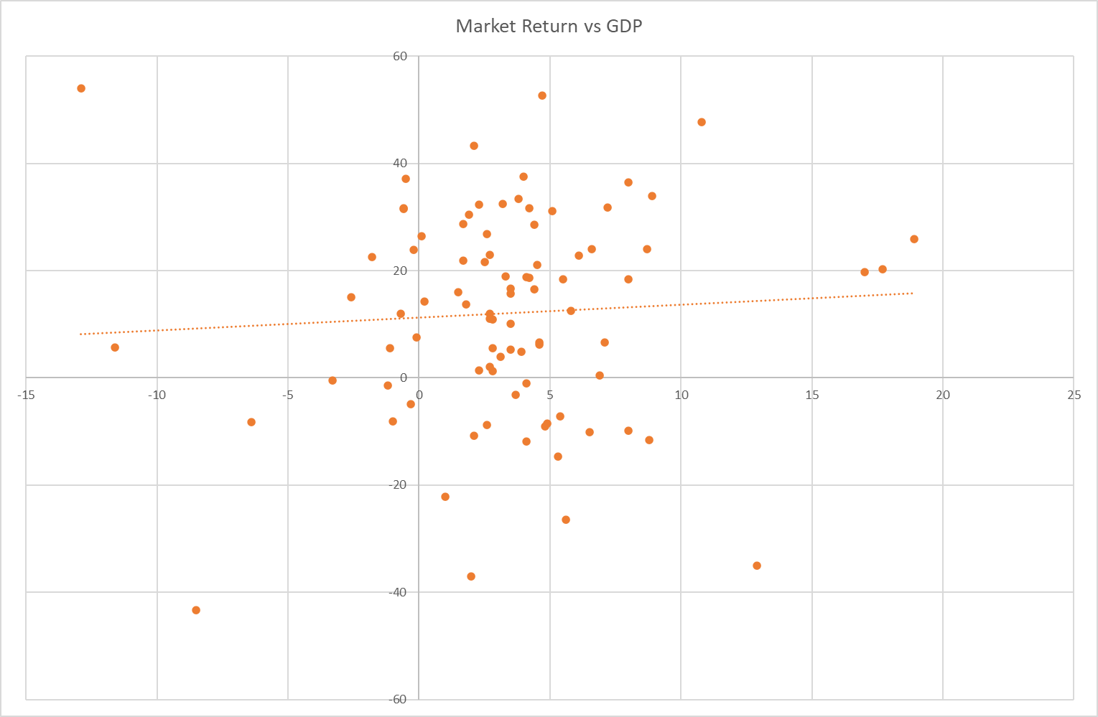
Market Timing – Returns vs GDP
Linking GDP with Market Returns in a popular trend
The data says the correlation is weak
Not easy to time the markets based on GDP or current year returns
What if you can time the markets?
*Period considered: 1926 - 2022

Slide 14
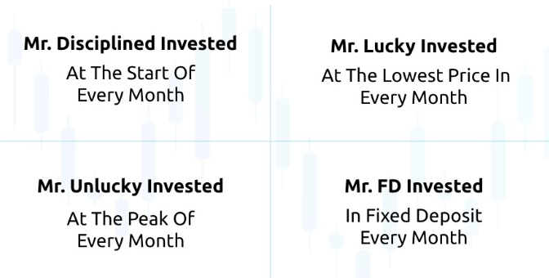
Market Timing case study
There are four types of investors. Each of them invested 10,000/month from July 1990 – Sep 2022. Mr. Lucky, Mr. Disciplined, and Mr. Unlucky invested in Nifty50.

Slide 15
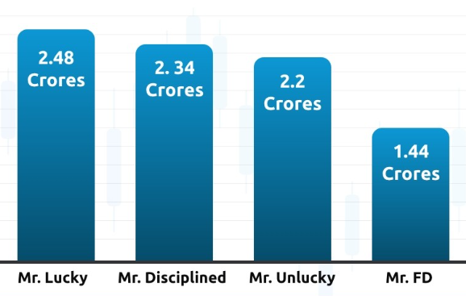
Market Timing case study
Each of them invested 38.7 Lakhs in Total
Impact of market timing: 5.98%
Mr. Lucky is better off compared to Mr. Unlucky only by 12.7%
Mr. Unlucky is better off compared to Mr. FD by 53%

Slide 16
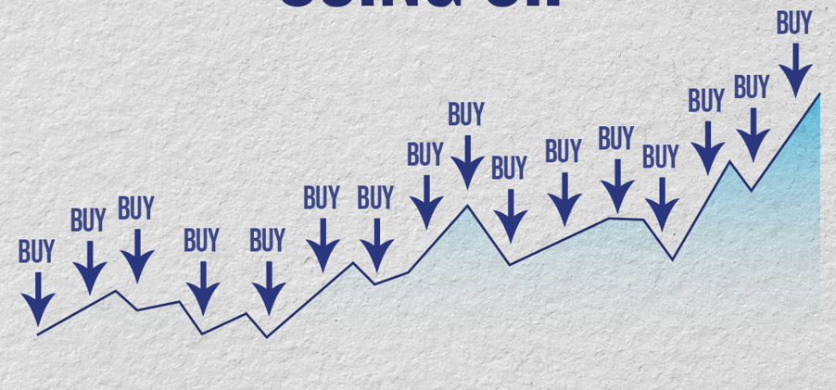
Market Timing case study
Time in the markets matters more
Power of compounding takes care of market timing
Follow SIP, be a disciplined investor
Stay invested!

Slide 17
Coming Episode
Staying the course
Measuring the performance

Slide 18
Thank You
FOLLOW US ON
Sandeep Tyagi
LinkedIn: https://www.linkedin.com/in/styagi/
Twitter: https://twitter.com/styagi
GULAQ
LinkedIn: https://www.linkedin.com/in/gulaqnew
Twitter: https://twitter.com/gulaqfintech
Instagram: https://www.instagram.com/gulaqfintech/

