Slide 1
Minimalist Art of Investing
Ep 10: Multifactor investing
Sandeep Tyagi

Slide 2
Recap: First 9 Episodes
Difficult to predict 1-year returns, easier to predict over long periods
10 Year Rolling returns (CAGR): Sensex → 11.2%, FD → 8.2%, 60-40 model portfolio → 10.76%
Investment Planning for 3 big goals (Templates provided on Gulaq.com):
Retirement Planning
Buying a home
Children’s education
Gear based investing: Take risk survey and find out your risk appetite
Get any gear by mixing only two ingredients: Equity and Fixed income
Active vs Passive investing: Figure out what kind of investor you are
Avoiding Noise in investing and stay disciplined
Measuring risk as well as return against the benchmark

Slide 3
OFFER FOR FREE CONSULTATION
Follow us on social media
Tag us
Make a request
FOLLOW US ON
Sandeep Tyagi
LinkedIn: https://www.linkedin.com/in/styagi/
Twitter: https://twitter.com/styagi
GULAQ
LinkedIn: https://www.linkedin.com/in/gulaqnew
Twitter: https://twitter.com/gulaqfintech
Instagram: https://www.instagram.com/gulaqfintech/

Slide 4
Fundamental analysis
Investors focus on company and the associated industry outlook while selecting the stock. Famous investors like Warren Buffet, Rakesh Jhunjhunwala typically follow this approach. They analyse the following:
Business prospects
Management strength
Competitive landscape
Strength of products and services offered
Trends in revenues, profits, margins
Human judgement based on historical information and extrapolation of future events.

Slide 5
Quantitative models
The focus is more on historical data in quantitative models. Quantitative investing firms use dozens of factors and club them to create a sophisticated portfolio.
Factors performance
Sectoral trends
Macroeconomic indicators
Price and volume indicators
Investor actions
Index participation
Many more
Assess potential performance based on historical data and the patterns in them.

Slide 6
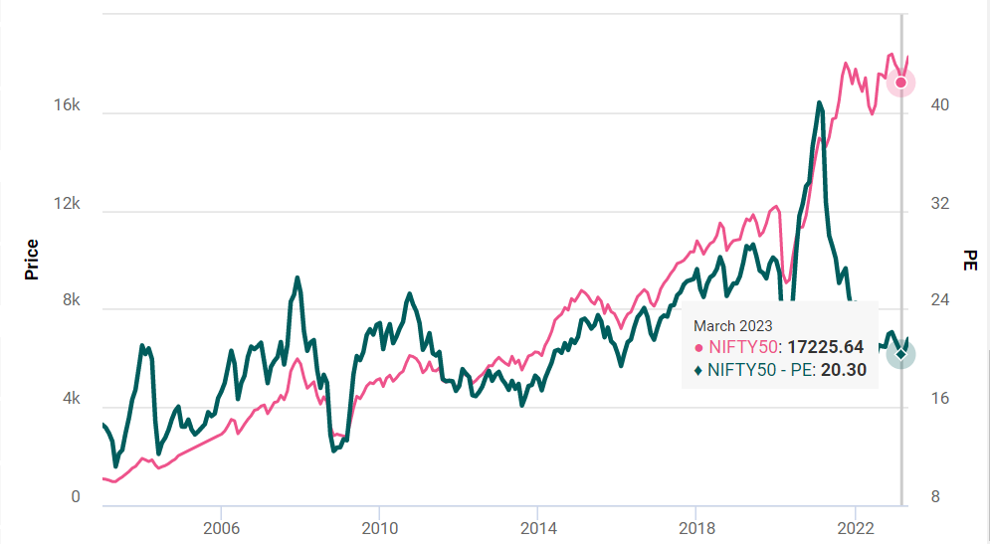
Factors - Value
The company’s business is valued to its intrinsic ability to generate earnings.
Common measure is Price to Earnings (PE) ratio
If Rs. 1000 priced stock generates 100 a year, PE is 10
Lower PE companies are assumed to appreciate in value
Other measures for value include
price to cashflow, book value vs market value, etc.,
*source: Trendlyne

Slide 7
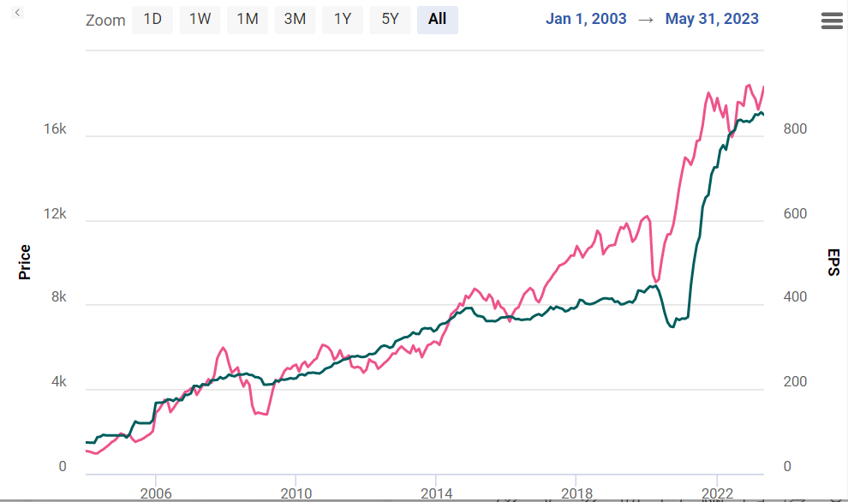
Factors - Value
The company’s business is valued to its intrinsic ability to generate earnings.
*source: Trendlyne

Slide 8
Factors - Growth
Growth investing refers to investing in those firms which are likely to grow more than average growth rate in the industry.
In last 20 years, major market appreciation came from Amazon, Facebook, Google, etc.,
These businesses consistently grew in revenues and earnings
Key measures to track:
Revenue growth
Earnings growth
Profit margins
Returns on Equity

Slide 9
Factors - Quality & Low Volatility
Quality
Reflects the strength of a company’s financial health
Investors assess relation between earnings and actual cash generated
Low debt to equity ratio, steady earnings growth, high profitability
Strength of balance sheet
Low Volatility
Measures stability and robustness of earnings
Company with consistent growth is considered better

Slide 10
Factors – Technical indicators
Technical indicators rely on price and volume information of a stock
The patterns found in price and volume data is used to predict future movement
Proponents of chart indicators say that emotions drive markets and creates patterns
They believe these chart patterns help in predicting market movement
Technical indicators examples
Bollinger Bands
Candlestick patterns
Golden Cross
Exponential moving averages
Relative strength index

Slide 11
Factors – Investor holding
Details of which investors are buying and selling can hint at stock price movement
Highly knowledgeable institutional investors accumulating stock is a positive signal
Trades of insiders is a good indicator, since they know more than an average investor
Promoters
Management
Directors
Their actions reveal their confidence about the stock price movement

Slide 12
Factors – Index participation
Index participation means passive investing
The world is increasingly moving towards index investing
Change in the size of index, impacts the stocks being part of that index
As the index funds grow, the demand for stocks in that index increases
As a result, stock prices goes up
It matters which stock is getting added to the index or removing from the index

Slide 13
Factors – Macro Environment
Each of the following factors behave differently in different markets and can influence stock prices.
Political factors
Economic environment
Interest rate
Inflation
GDP Growth rate
Demographics
Exchange rate

Slide 14
Portfolio construction using factors
At Estee, we track and analyze 130+ such factors while creating multi-factor Gulaq portfolios
We rank stocks on each of the factor
We assign certain weight to each of the factor considered
We combine all stocks selected by different factors, to create an overall portfolio
Using this weighted approach, we get overall a balanced portfolio
We build and refine these multi-factor models to optimize portfolio performance

Slide 15
Long-short model insights
Building Blocks
Dynamic Factor Combination
Regime Estimators
Index Reconstitution
Institutional Holding
Multi-Signal Library
Long Short Portfolio
Sector/Industry Rotation
Market Microstructure
Regime Estimators
130+ Micro Strategies
Feedback based system
Regularly re-assess positions and churn the portfolio
Macro Level Regime Analysis
Factor Weight Assignment
Model Portfolio

Slide 16
Gulaq Multi-factor investing approach
Large Cap, Mid Cap, Small Cap
Momentum, value, Low-vol, Growth, etc.
FMCG, IT, Utilities, Healthcare, etc.
Gulaq Balanced Portfolios
“Gulaq balanced portfolios focus primarily on consistent performance with diversification across market caps, factors, and sectors. This approach helped us avoid extreme cases, and beat benchmark consistently”
Gulaq balanced portfolios track 130+ factors
Gulaq flagship portfolio – Gulaq Gear 6 – has outperformed benchmark consistently
The well diversified portfolio has given 56% CAGR since launched in May 2020

Slide 17
Gulaq Balanced portfolio performance
Gulaq Gear 6 is launched in May 2020. A 100 invested in Gulaq Gear 6 and in Nifty Multi Cap would have grown to 385 and 208 respectively.
*Data as on 29 May 2023

Slide 18
Coming Episode
Rebalance and Market Review

Slide 19
Thank You
FOLLOW US ON
Sandeep Tyagi
LinkedIn: https://www.linkedin.com/in/styagi/
Twitter: https://twitter.com/styagi
GULAQ
LinkedIn: https://www.linkedin.com/in/gulaqnew
Twitter: https://twitter.com/gulaqfintech
Instagram: https://www.instagram.com/gulaqfintech/

